Slide 1
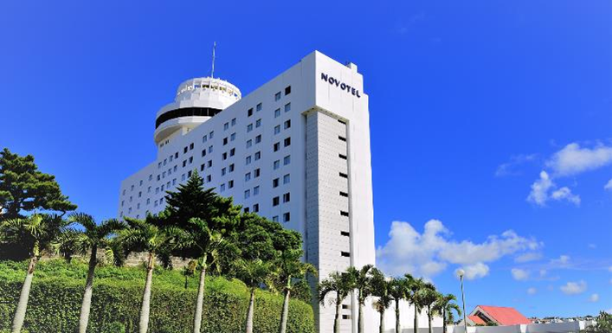
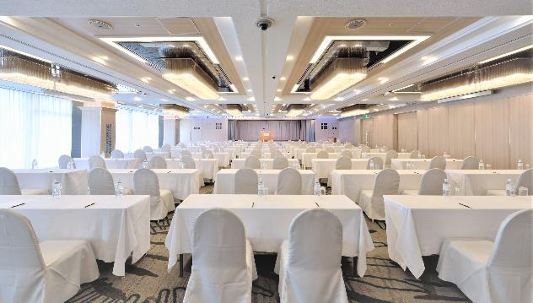
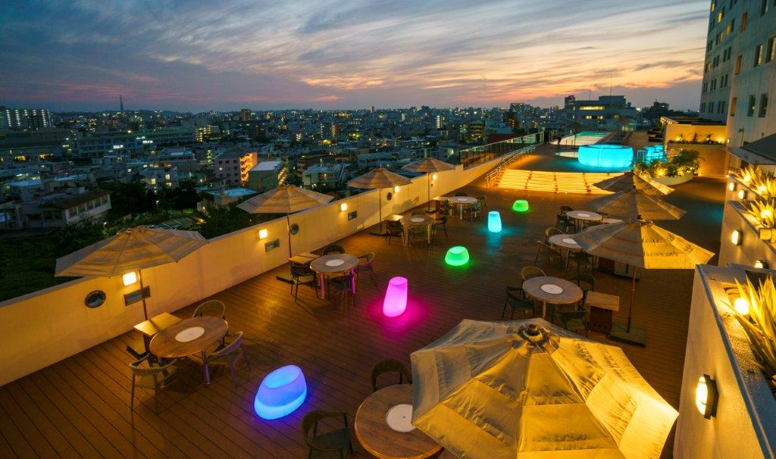

Novotel Okinawa Naha
We offer three banquet rooms and a private poolside BBQ terrace.
L`arbre
Banquet Rooms | Capacity |  |  |  | Area（㎡） | Celling Heght(m)
 | Theater | Classroom | Banquet Style | Buffet Style
L`arbre | 540 | 260 | 216 | 350 | 410 | 2.8～3.8
Le ciel | 430 | 210 | 150 | 250 | 330 | 2.8～3.8
Le vent | 290 | 130 | 120 | 200 | 250 | 2.85～4.05
BBQ Terrace
Easy access to the airport and northern Okinawa. Just a 15-min walk to Shuri Castle and Ryukyu culture experiences nearby.
Basic Information
Address: 40 Matsukawa, Naha, Okinawa, Japan TEL: +81-98-887-1111
Access: Approx. 25 minutes by car from Naha Airport / Approx. 40 minutes by Route Bus No.125
Number of Rooms: 328 (Maximum Capacity: 1,082 guests)
Exclusive Use: Available

